Slide 1
Final Presentation
Use Monte Carlo to Price American Options
Junyi Zhang

Slide 2
European Option
A European option is a version of an options contract that limits execution to its expiration date. In other words, if the underlying security such as a stock has moved in price an investor would not be able to exercise the option early and take delivery of or sell the shares. Instead, the call or put action will only take place on the date of option maturity.
Generally, we use Black-Scholes Formula For European Options

Slide 3
Black Shoes Formula
The Black Scholes call option formula is calculated by multiplying the stock price by the cumulative standard normal probability distribution function. Thereafter, the net present value (NPV) of the strike price multiplied by the cumulative standard normal distribution is subtracted from the resulting value of the previous calculation.

Slide 4

Black Shoes Formula
In mathematical notation:
C =$S_{T}N(d_{1})−Ke^{−rt}\text{N}\text{(​}d_{2}\text{)}$, where $d_{1}$ = $\frac{ln⁡(\frac{S_{T}}{K}) +(r+ \frac{σ_{v}^{2}}{2}\text{)}T}{σ\sqrt{T}}$, $d_{2}$ = $d_{1}$ - $σ\sqrt{T}$
Symbol:
C = Call option price
S = Current stock (or other underlying) price
K = Strike price
R = Risk-free interest rate
T = Time to maturity
N = A log-normal distribution​
$σ$ = standard deviation of log returns(volatility)

Slide 5
American Option
An American option is a style of options contract that allows holders to exercise their rights at any time before and including the expiration date.
An American-style option allows investors to capture profit as soon as the stock price moves favorably.

Slide 6
American Option
Closed form formula does not exist, need to resort to numerical methods
One of the most common way: American Monte-Carlo

Slide 7
Monte-Carlo
As with other option pricing techniques Monte-Carlo methods are used to price options using what is essentially a three step process.
The three steps are:
1. Calculate potential future prices of the underlying asset(s) by generating a random sample.
2. Calculate the payoff of the option for each of the potential underlying price paths.
3. Discount the payoffs back to today and average them to determine the expected price.

Slide 8
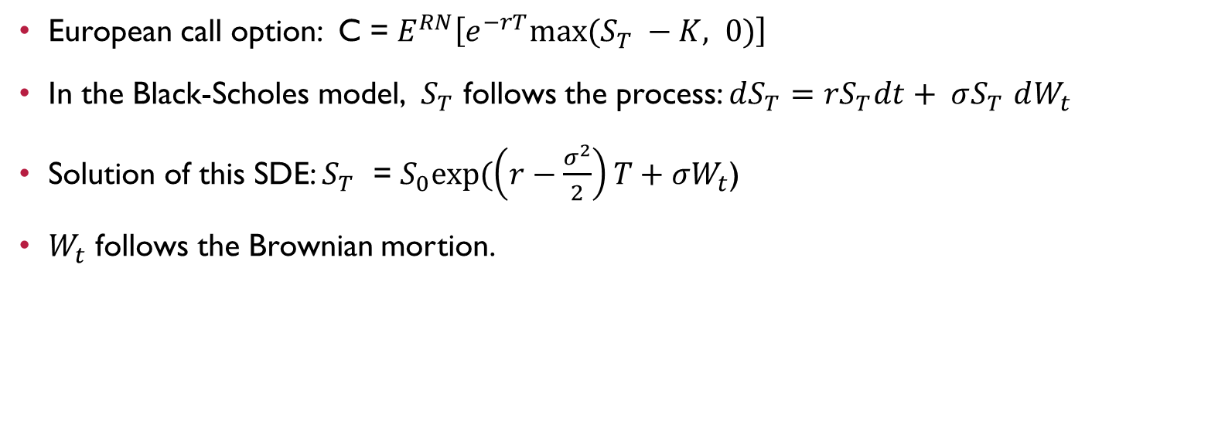
Using Monte-carlo simulation for European option
European call option: C = $E^{RN}\left[e^{−rT}max⁡(S_{T} −K, 0)\right]$
In the Black-Scholes model, $S_{T}$ follows the process: $dS_{T}=rS_{T}dt+ σS_{T}$ $dW_{t}$
Solution of this SDE: $S_{T}$ = $S_{0}exp⁡(\left(r−\frac{σ^{2}}{2}\right)T+σW_{t}$)
$W_{t}$ follows the Brownian mortion.

Slide 9
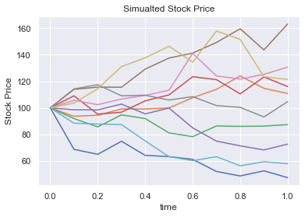
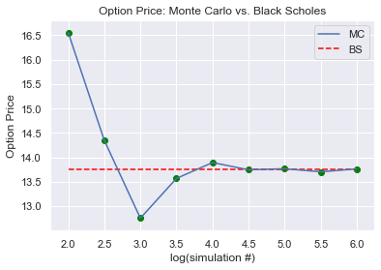
Using Monte-carlo simulation for European option

Slide 10
Problem of American option for using Monte Carlo
Monte Carlo doesn’t use backward induction
Monte Carlo methods are required for options that depend on multiple underlying securities or that involve path dependent features. Since determination of the optimal exercise time depends on an average over future events, Monte Carlo simulation for an American option has a “Monte Carlo on Monte Carlo” feature that makes it computationally complex

Slide 11
Broadie Glasserman scheme
The continuation value is the value of the option if we continue to hold it
As such it is the risk-neutral expectation of the payoff of the option, we need to be able to calculate conditional expectations in Monte Carlo.
But this conditional valued does not depend on how we get there
To calculate the continuation value, we could start a sub-Monte Carlo there
This is very expensive computationally !

Slide 12
More efficient solution CONDITIONAL EXPECTATION BY REGRESSION
This method was invented by Longstaff and Schwartz, who are the professors in UCLA, in 2001.
The technique called least squares Monte Carlo(LSM) approach
The key insight is that the conditional expectation can be estimated from the cross-sectional information in the simulation by using least squares

Slide 13
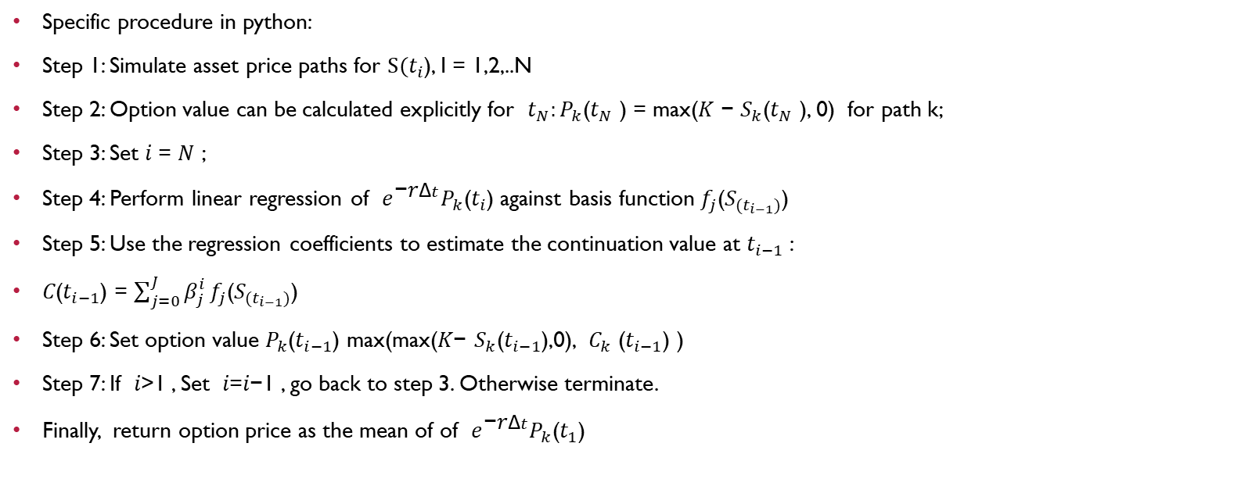
least squares Monte Carlo(LSM) approach
Specific procedure in python:
Step 1: Simulate asset price paths for $S(t_{i}$), I = 1,2,..N
Step 2: Option value can be calculated explicitly for $t_{N}:P_{k}$($t_{N}$ ) = max(𝐾 − $S_{k}$($t_{N}$ ), 0) for path k;
Step 3: Set 𝑖 = 𝑁 ;
Step 4: Perform linear regression of $e^{\text{−}\text{r}\text{Δ}t}P_{k}\text{(}t_{i}\text{)}$ against basis function $f_{j}$($S_{(t_{i−1})}$)
Step 5: Use the regression coefficients to estimate the continuation value at $t_{i−1}$:
𝐶($t_{i−1}$) = $\sum_{j=0}^{J}{β_{j}^{i}}f_{j}$($S_{(t_{i−1})}$)
Step 6: Set option value $P_{k}$($t_{i−1}$) max(max(𝐾− $S_{k}$($t_{i−1}$),0), $C_{k}$ ($t_{i−1}$) )
Step 7: If 𝑖>1 , Set 𝑖=𝑖−1 , go back to step 3. Otherwise terminate.
Finally, return option price as the mean of of $e^{\text{−}\text{r}\text{Δ}t}P_{k}\text{(}t_{1}\text{)}$

Slide 14
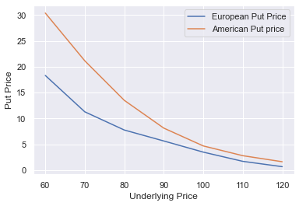
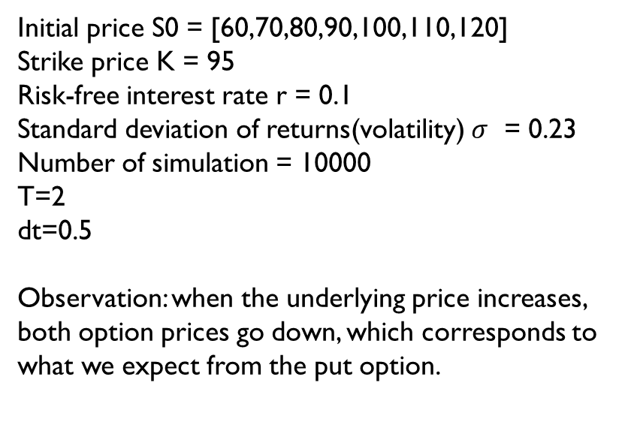
least squares Monte Carlo(LSM) approach
Initial price S0 = [60,70,80,90,100,110,120]
Strike price K = 95
Risk-free interest rate r = 0.1
Standard deviation of returns(volatility) $σ$ = 0.23 Number of simulation = 10000
T=2
dt=0.5
Observation: when the underlying price increases, both option prices go down, which corresponds to what we expect from the put option.

Slide 15
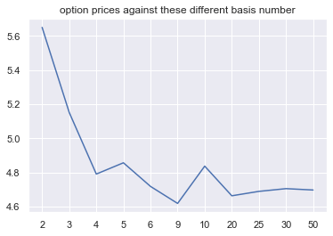
Further Improve
Try with different number of basis functions (default is 6): 2,3,4,5,6,9,10,20, 25, 30,50.
As we can see, when we set the basis function value to 4 or above, our OLS regression is good enough to estimate the continuation value to calculate the put option price.
Intuitively, the reason why the baseline value is 4 is that we have totally 4 time period in our simulation(T/dt = 2/0.5=4). Thus, if we can infer that the more appropriate basis number should be at least equal to the number of the time period

Slide 16
Further Improve Using Hesten model
The Heston Model, named after Steve Heston, is a type of stochastic volatility model used by financial professionals to price European options.
The Heston Model makes the assumption that volatility is arbitrary, a key factor that defines stochastic volatility models, which is in contrast to the Black-Scholes model, which holds volatility constant.
The Heston Model is a type of volatility smile model, which is a graphical representation of several options with identical expiration dates that show increasing volatility as the options become more ITM or OTM.

Slide 17
Heston Model VS constant volatility
It factors in a possible correlation between a stock's price and its volatility.
It conveys volatility as reverting to the mean.
It gives a closed-form solution, meaning that the answer is derived from an accepted set of mathematical operations.
It does not require that stock price follow a lognormal probability distribution.

Slide 18
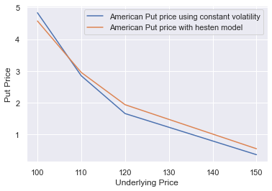
Result of using Heston

Slide 19
Summary
American options may exercise at any time before the option expires, while European options may exercise only at expiration.
We can use Black Shoes Model to solve European options, while we have to adopt numeric method: Monte Carlo Simulation to solve American options.
Traditional method of Monte Carlo Simution, Broadie Glasserman scheme, is computationally expensive. The more efficient way is to use simple OLS regression to calculate the conditional expectation.
The Heston model may be more appropriate way for stock simulation, because it assumes that volatility is arbitrary, which is in contrast to the Black-Scholes model, which holds volatility constant.

Slide 20
Reference
Li, Steven. Introduction to Option Pricing.
Li, Steven. Introduction to Monte Carlo methods.
Li, Steven. American Monte Carlo.
Li, Steven. Monte Carlo Simulation Simulate Stochastic Differential Equations (SDE)
Investomedia. https://www.investopedia.com/.
Longstaff, F.A.; Schwartz, E.S. (2001). "Valuing American options by simulation: a simple least squares approach". Review of Financial Studies. 14: 113–148. CiteSeerX 10.1.1.155.3462. doi:10.1093/rfs/14.1.113. Retrieved June 28, 2012.

Slide 21
Thank you!
Junyi Zhang

